Slide 1
Using Turnitin for Formative Feedback
Karen Robins – May 2010
k.robins@herts.ac.uk

Slide 2
Aims of Session
To be aware of the benefits of using Turnitin for formative feedback;
To be able to set up Turnitin for an assessment;
  To describe how Turnitin can be used for formative feedback;
To interpret the Turnitin report;
  To discuss good practice on use Turnitin for formative feedback;
  To know where and what support is available - guide / video / workshop.
Karen Robins

Slide 3
Why provide students with formative feedback from Turnitin?
  To improve student academic writing by;
  To improve the originality of student work;
  To emphasise the importance of learning to paraphrase;
  To improve students referencing skills;
  To reduce accidental plagiarism;
  Policy – all dissertations and projects to have opportunity to use Turnitin for formative feedback.
Karen Robins

Slide 4
Turnitin UK Plagiarism Detection
Student work is compared against
Current and previous Internet sites
Published work form from periodicals, journals and databases.
Student assessment submitted to Turnitin from1996
Essays from cheat websites
Note – Turnitin does not find all sources (approximately 50%)
Karen Robins
Notes:
What does Turnitin Search?
1) First, it searches a current copy and an archived copy of the publicly accessible Internet (more than 5 billion pages indexed so far). Our web crawler technology allows for a more directed search for new and updated text (so that it does not waste time downloading material that educators are not interested in). The archived copy addresses the issue of web sites that disappear over time.
2) In addition to Internet text, Turnitin searches millions of published works including scholarly journals and newspapers. We are the only service to include data of this kind that provides searches to a vast array of private periodicals, journals, and publications.
3) Most importantly, our search area includes millions of student papers submitted to Turnitin since 1996. This means that we have the largest database of previously submitted work. This is also the only way to combat two forms of plagiarism:
1) the use of the for-pay-cheat-site papers that students can buy and download and
2) internal sharing of original work between students in the same classes.
In addition, IT IS VERY IMPORTANT TO NOTE: that a previously submitted paper match does not show any identifying information or any of the actual paper from the previous student. We follow FERPA and COPPA student privacy policies. You do get a communication box that appears so you can e-mail the faculty member who received this paper to follow up from a teacher to teacher perspective. I will show your this in a minute.
It is also very important to note that Turnitin complies with all copyright laws. (Click to next slide)

Slide 5
Using Turnitin for Formative Feedback
Module level
Student papers/assignments do not have to be written to the Turnitin database
  Overwrite option – updates assignment, cannot see any previous versions
  Draft option – shows draft and final versions
  Revision – keeps all previous versions
  24 hour delay between each submission
School / Faculty
  Give students open access to Turnitin
Institutional level
Dissertation and projects policy
May need to set Turnitin advanced settings so that assignments are not written to the Turnitin database
Karen Robins

Slide 6
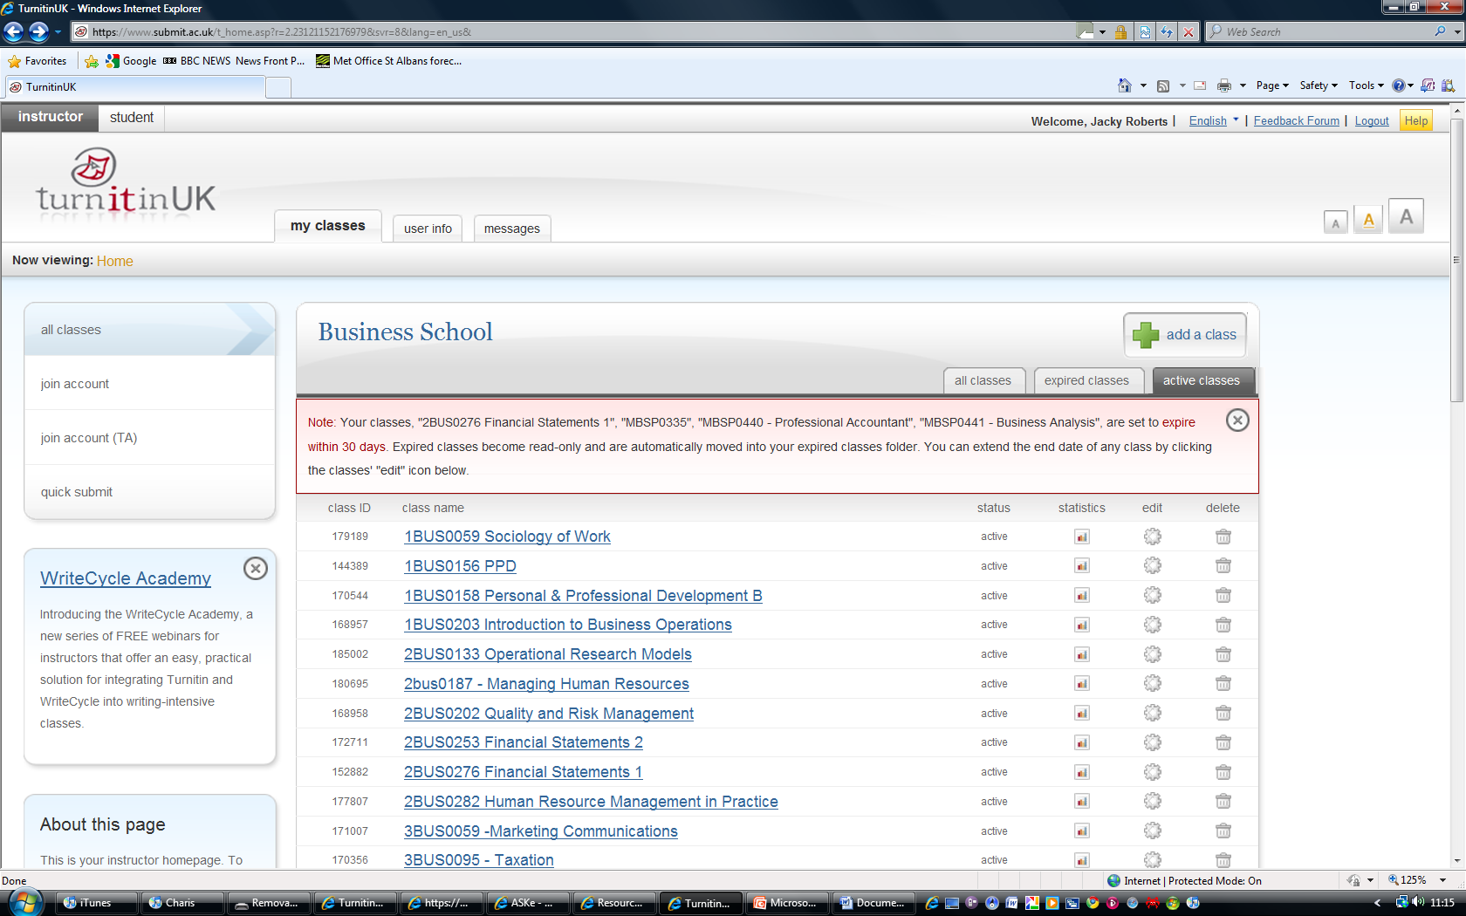
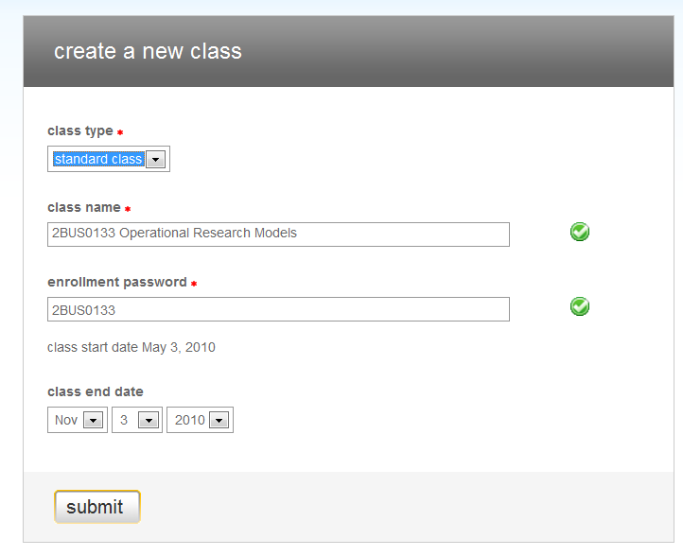
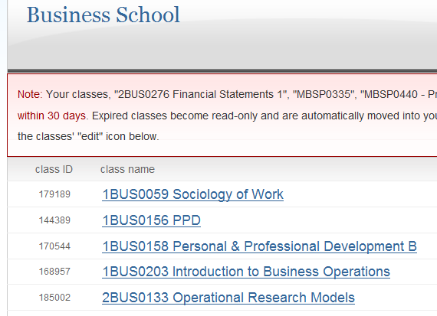
Add a class in Turnitin (module)
1
Add a class(module)
Add class name and enrolment password
Click on the module to create an assignment
2
3
Karen Robins

Slide 7
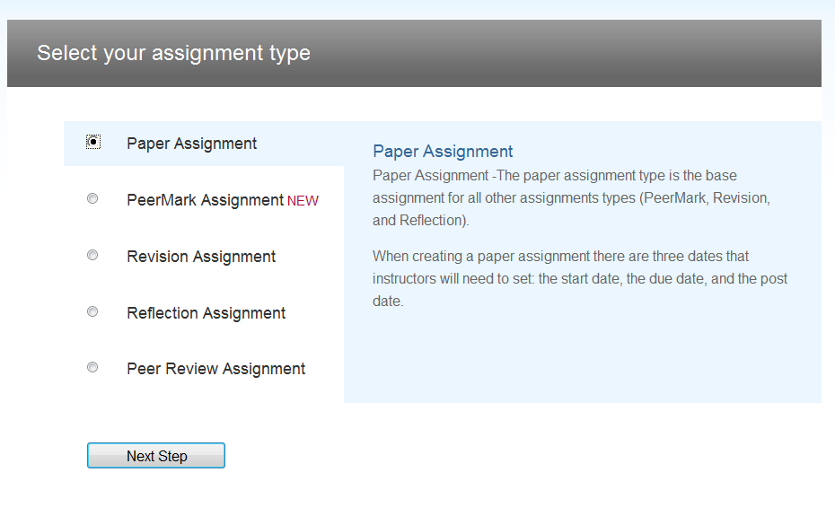
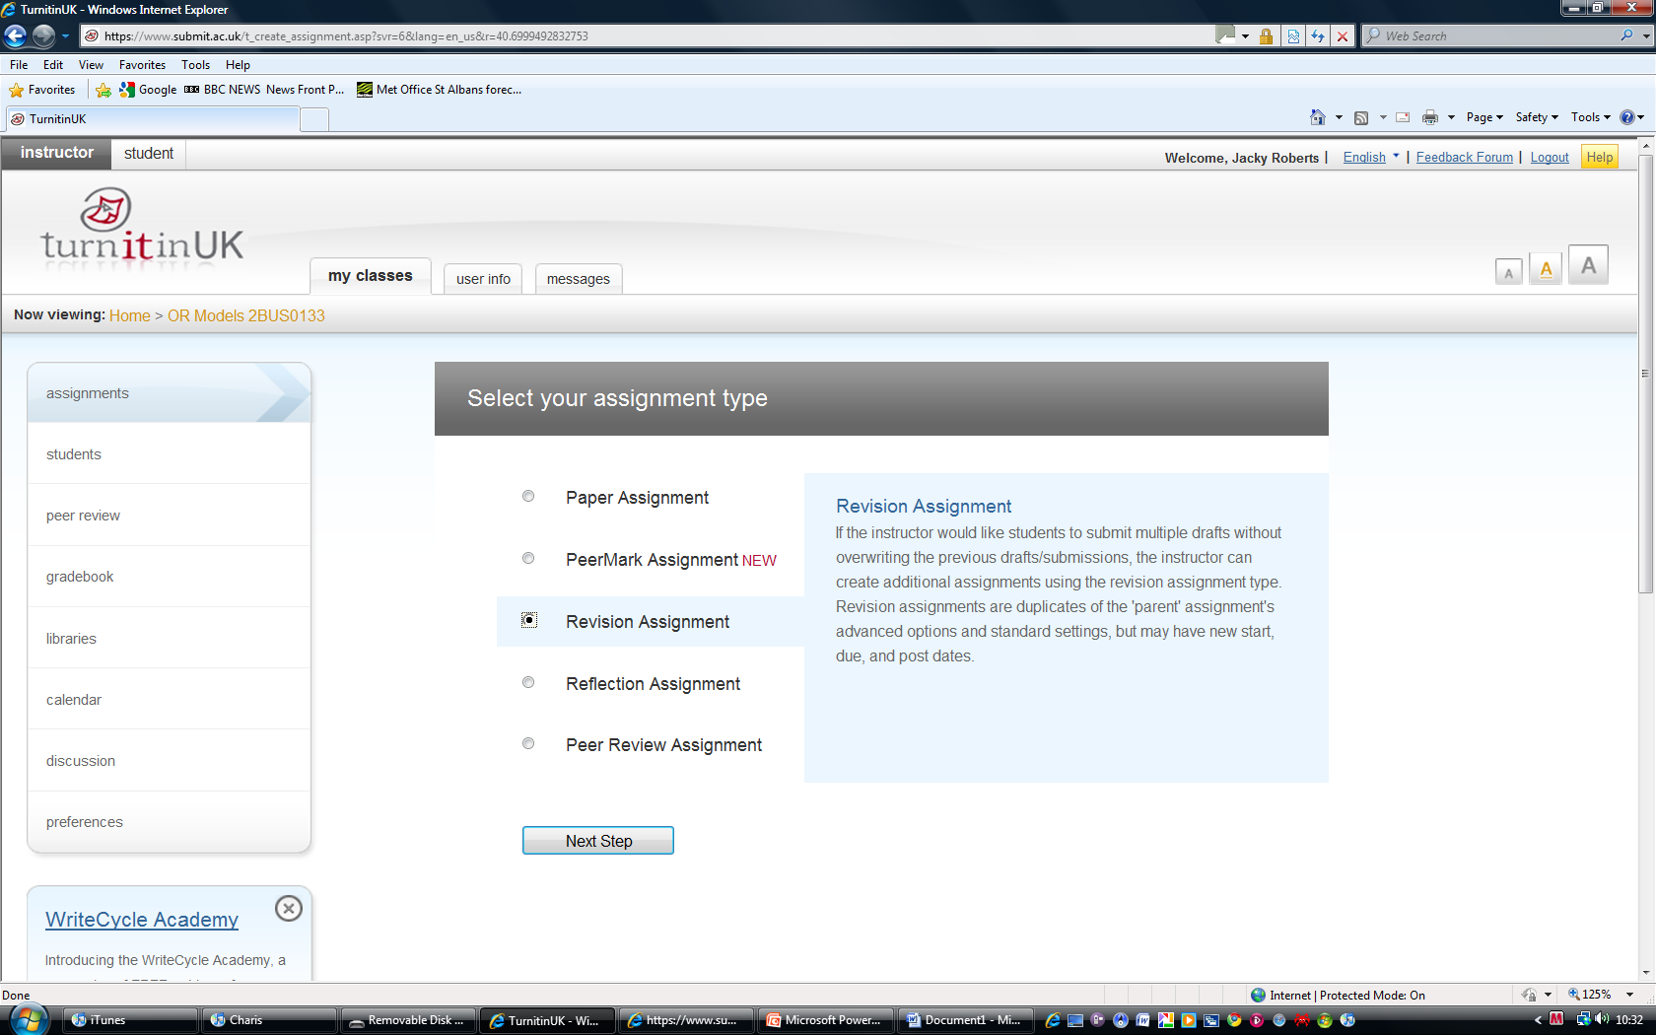
Types of assignment

Slide 8
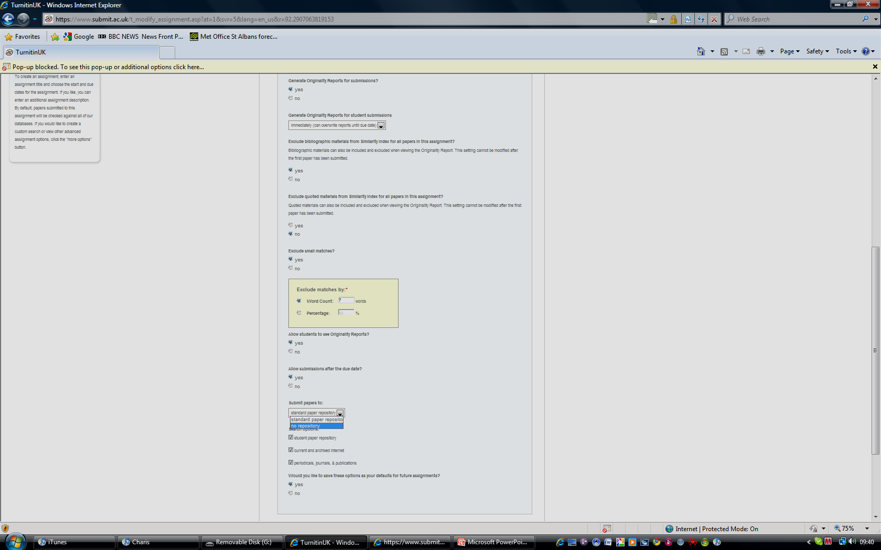
Advanced settings
Immediately
- can overwrite until due date
Can set individual matches <1% or number of words
Allow students to see the originality reports
No repository
– student submissions not saved to database but should be searched against it

Slide 9
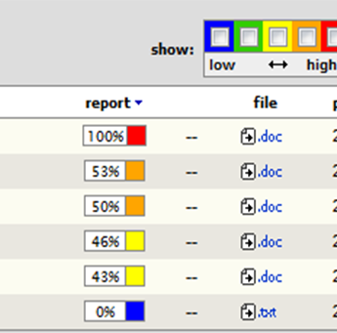
Overall Similarity Index
The overall similarity index colour coded, red indicates text matching in excess of 75%;
The report does not distinguish between properly referenced and unacknowledged work;
It is possible to exclude quoted material and bibliographies;
It is possible to exclude small matches as either a percentage or number of words;
If the student has previously submitted the same paper for another module, it will compare the latest submission with the previous submission.
Karen Robins

Slide 10
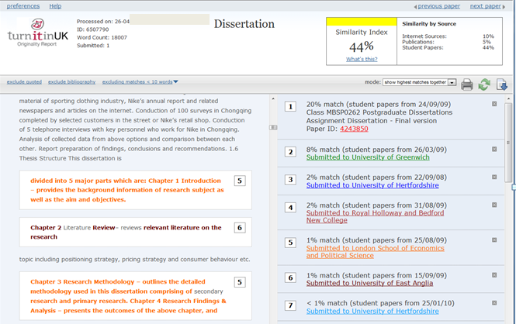
Interpreting theTurnitin Report
Karen Robins

Slide 11
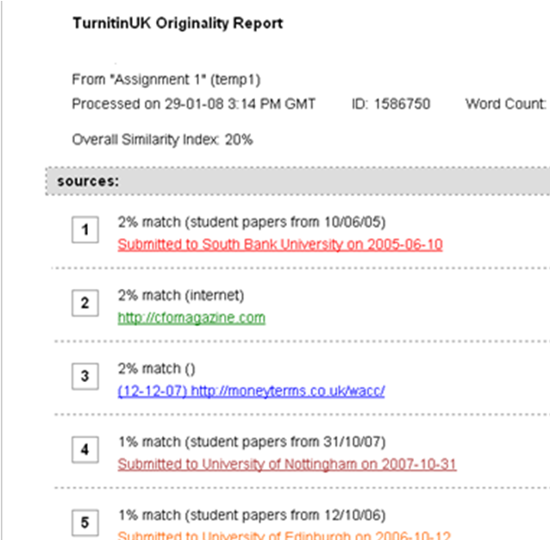
Helping students interpret the Turnitin Report
Is this student guilty of plagiarism with a similarity index of 20%
Could be considered as highly derivative.
What percentage is safe?
What should we tell students?
Karen Robins

Slide 12
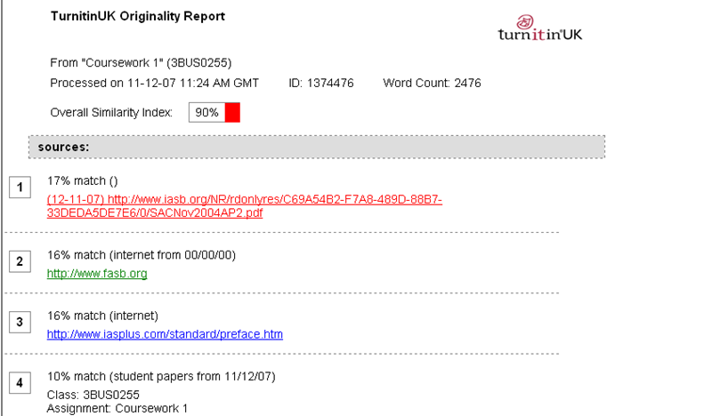
Turnitin Report
Collusion?

Slide 13
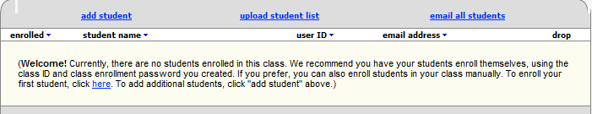
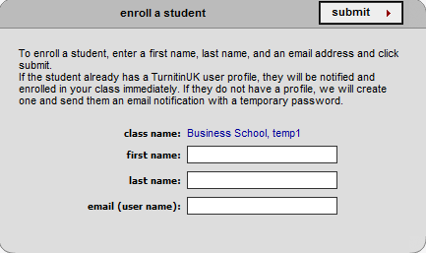
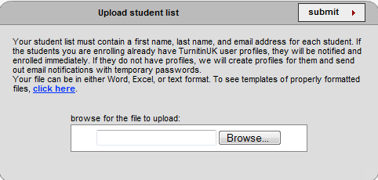
Enrolling students on Turnitin
  Students can enrol themselves by creating a user profile and using your class ID and password OR
  You can manually enrol your students by uploading 100 names at a time from an Excel file directly into Turnitin
Karen Robins

Slide 14
Good practice on use of Turnitin for formative feedback
  Allow all new students to the University to use Turnitin for formative feedback;
  Embed into a module on their programme (skills modules);
  Give enough time for student to act on feedback;
  Discuss the originality report with the student;
  Staff to set up a tutorial/seminar exercise (class) on Turnitin (needs computer lab);
  Request students submit to directly to Turnitin (and StudyNet);
  Set up linked assessment for formative and summative exercise.
  Given the option, not all students will take up the opportunity of formative feedback, need to build something into the assignment to encourage submission. e.g. Negative marks on summative piece.
Karen Robins

Slide 15
Supporting Students
Not enough to only inform students
Induction week, give referencing and research sessions for students;
Use Turnitin for a formative assignment;
Explain the originality report to students;
Put links to quizzes on plagiarism on programme and module sites (see IH resources);
Design out plagiarism – see ASKe handout.
Karen Robins

Slide 16
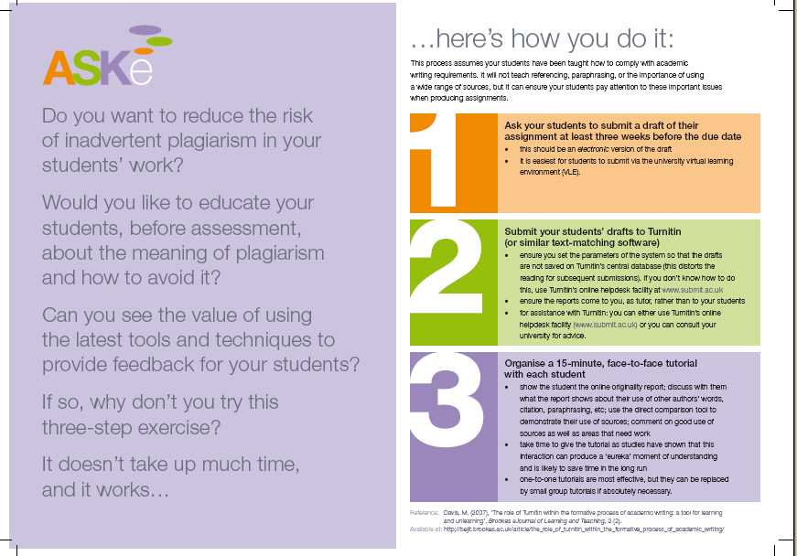
Using Turnitin to provide powerful formative feedback
http://www.brookes.ac.uk/aske/resources.html

Slide 17
Next steps
Provide a range of support for staff and students on using Turnitin;
Create a central provision on Turnitin for staff and students (Information Hertfordshire);
  Information Hertfordshire website - Turnitin
Increase awareness and reduce fear of the technology for both staff and students.
Karen Robins

Slide 18
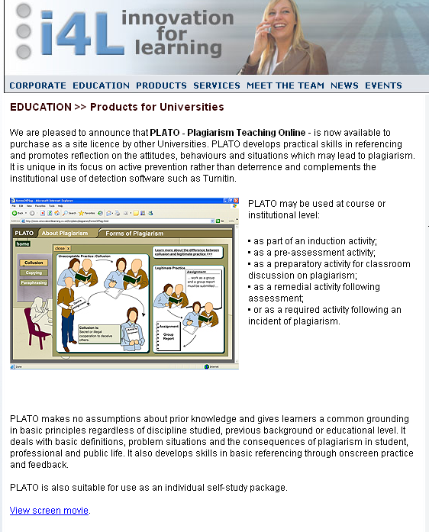
Plato – Plagiarism teaching online
Pricing – Higher Education:
Up to 5,000 FTE students: £800
5000 to 10000 FTE students: £1200
10000 to 20000 FTE students: £1500
Over 20000 FTE students: £2000
Individual user: £30
It can be hosted on your own VLE.
One-off payment with no subscription fees.
View screen movie
Http://www.i4learn.co.uk/PLATOedited/PLATOedited.html
Or see it in action
http://bure.dundeecoll.ac.uk/bb6common/plato/homePg.swf

Slide 19
Help available
Instructor manuals and demos of Turnitin available at
http://www.submit.ac.uk/static/popups/user_manuals.html
TurnitinUK – User Manuals and Frequently Asked Questions (Instructor and student user guides)
http://submit.ac.uk
Assessment Standards Knowledge exchange, free resource leaflets
http://www.brookes.ac.uk/aske/resources.html
Note: All staff need to be individually registered on Turnitin
Karen Robins

Slide 20
Should Turnitin be available for all students for formative feedback on all their assignments.
Open Access?
Karen Robins

Slide 21
References
JISC Internet Plagiarism Service
www.jiscpas.ac.uk
Plagiarism Advisory Service – Funded by JISC
Turnitin UK Instructor FAQs
http://www.jiscpas.ac.uk/faqsearch.php?sol=turnitin_instructor
Mary Davis. (2007). Mary D. Available: http://bejlt.brookes.ac.uk/article/the_role_of_turnitin_within_the_formative_process_of_academic_writing/. Last accessed 23 June 2007
Karen Robins

